Slide 1
Comparison Between YOLO and SSD Algorithms for Video Real Time Object Detection
AI-894 Team 8
Dagmar Mojena Carrazana
Joshua Pauly
Josue Perez Gomez

Slide 2
ABSTRACT
This project compares two single shot detector models for the task of real-time object detection.
You Only Look Once(YOLO) and Single Shot Detector(SSD)
Using Pre-trained open-source models from Ultralytics(YOLO) and PyTorch(SSD) which were originally trained on the COCO dataset.
Fine tuning was done with a car-dashcam video dataset called Agroverse-HD.
Metrics like mAP, recall and inference time are used for the performance comparison.

Slide 3
introduction
Both YOLO and SSD are classified as one-stage detectors.
Applications for real-time object detection algorithms are such as surveillance and self-driving cars.
The project explores and compares two popular real-time object detectors; SSD & YOLO.
Both the YOLO & the SSD model were developed to deal with many frames per second.
The SSD model balances accuracy and inference speed by having multiple feature maps at different scales, whereas the YOLO model primarily focuses on runtime.

Slide 4
Previous works
Previous work include models like:
R-CNN, Fast R-CNN & Faster R-CNN
Previous algorithms are designed in two stages: Bounding Box and class score estimation. Followed by a classification of generated bounding boxes.
Drawbacks are:
Not optimal for real-time object detection.
Computationally expensive.

Slide 5
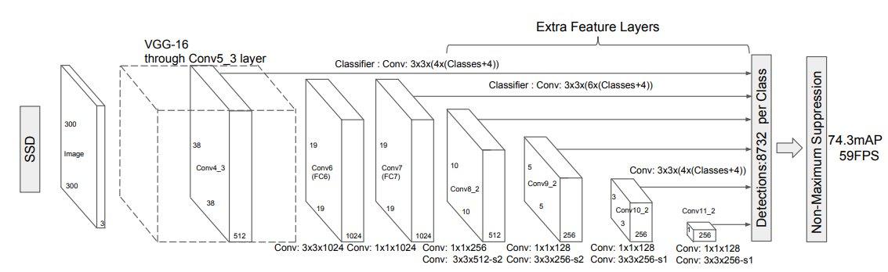
SSD Architecture
General Architecture has the following stages:
1) Feature map generator using a backbone network like VGG-16
2) Generate additional features, bounding boxes and scores at different scales with multiple CNNs
3) Select the best bounding box and classification score with Intersection over Union loss (IoU) and use NMS to remove redundant boxes.
Notes:
Liu, Wei, et al. SSD: Single Shot MultiBox Detector. 29 Dec. 2016.

Slide 6
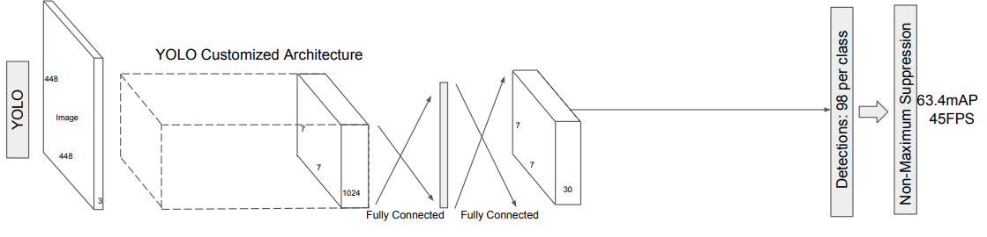
YOLO Architecture
General architecture has the following stages:
1) The input image is passed through a customized CNN backbone network, to extract feature maps.
2) It generates possible bounding boxes and a predictor for each object
3) Finally with NMS it reduces possible bounding boxes and selects the best bounding box and predictor.
Notes:
Liu, Wei, et al. SSD: Single Shot MultiBox Detector. 29 Dec. 2016.

Slide 7
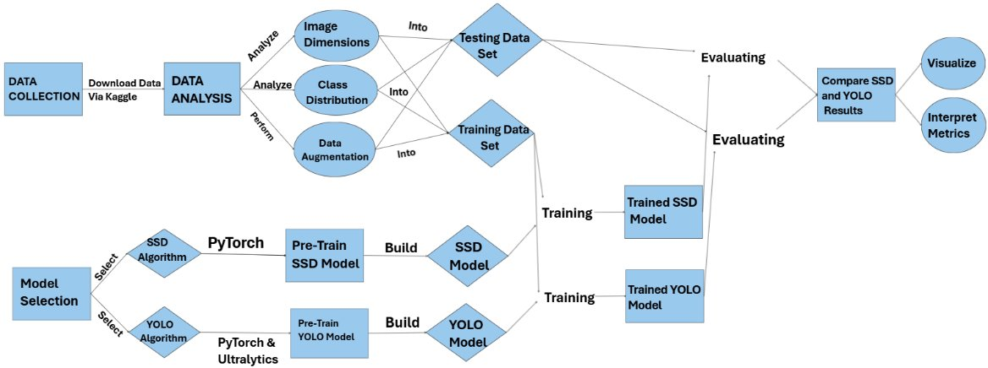
WORKFLOW

Slide 8
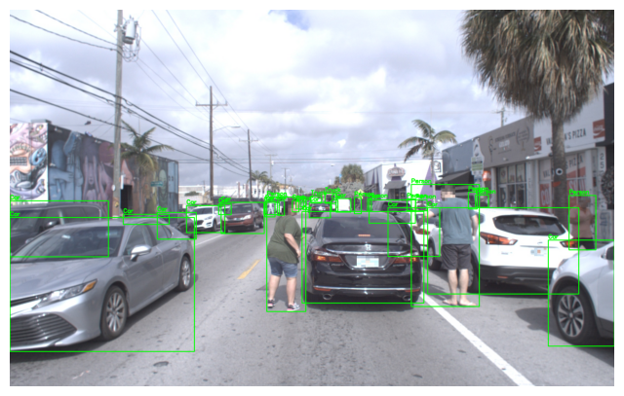
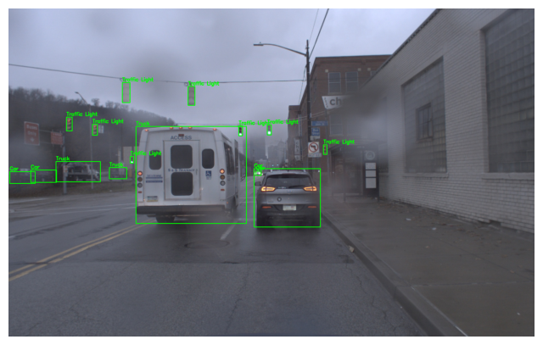
Data source
Agroverse-HD: JPEG Images from 113 video sequences and a JSON file with boundary box locations and classes
65 videos for training 39,384 images
24 videos for validation 15,062 images
Approximately 1.3 million annotated objects
Classes: person, bicycle, car, motorcycle, bus, truck, traffic light and stop sign.

Slide 9
Model selection
Two most widely used models for real time object detection: YOLO and SSD
Finetuned pretrained models
YOLOv11 from Ultralytics
SSD300 from Pytorch

Slide 10
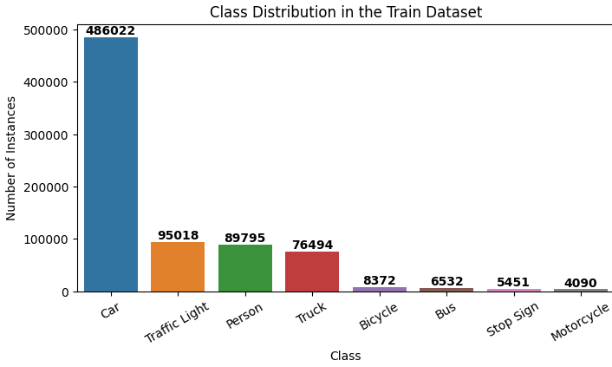
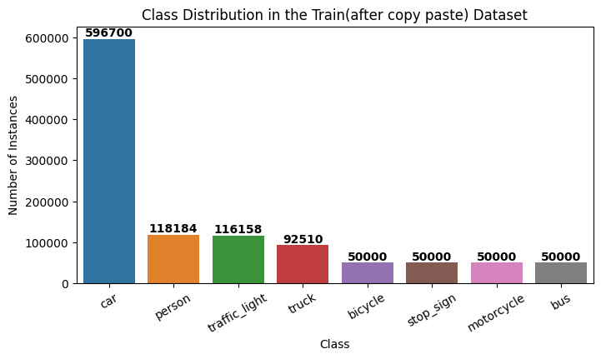
Data processing
Class imbalance
Used copy and paste method to increase underrepresented classes
Performed horizontal flipping augmentation on images that contained underrepresented classes
Augmentation: Blurring, brightening, contrast changes and hue shift were applied

Slide 11
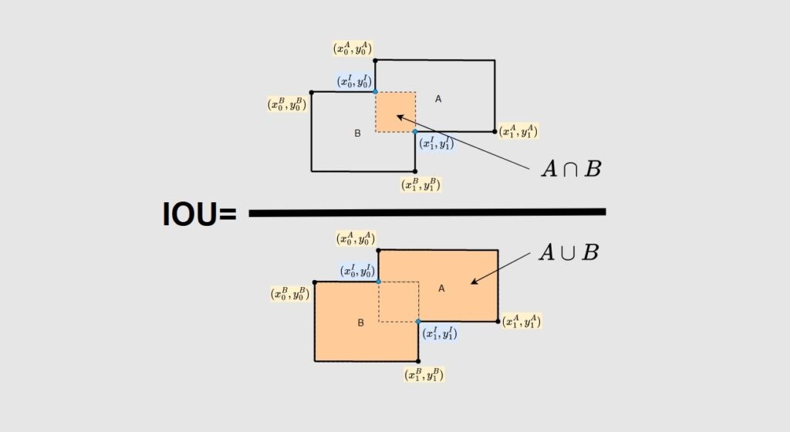
training
YOLO Hyperparameters: learning rate = 0.0001, weight decay = 0.01, patience = 5, batch size =16 and optimizer = AdamW. Training was terminated at 17 epochs after no improvement was made preventing overfitting
SSD Hyperparameters: learning rate = 0.00005, weight decay = 0.001, patience = 10, optimizer = AdamW. Training was terminated at 16 epochs after no improvement was made preventing overfitting
Two loss functions were used for both models:
Intersection over Union (IoU) loss function to calculate predicted boxes coverage of the truth boxes.
Classification loss function

Slide 12


Metrics
Mean Average Precision(mAP50) -
Mean Average Precision(mAP50:95) -
Recall = True Positives / (True Positives + False Negatives)
Confusion Martix shows predicted values compared to actual values
Inference speed is the average calculation to determine prediction on an image measured in ms

Slide 13
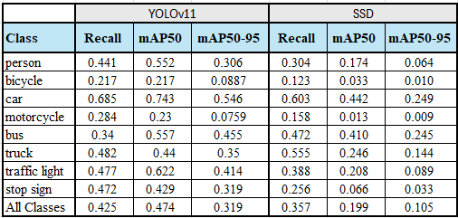
Results - map

Slide 14
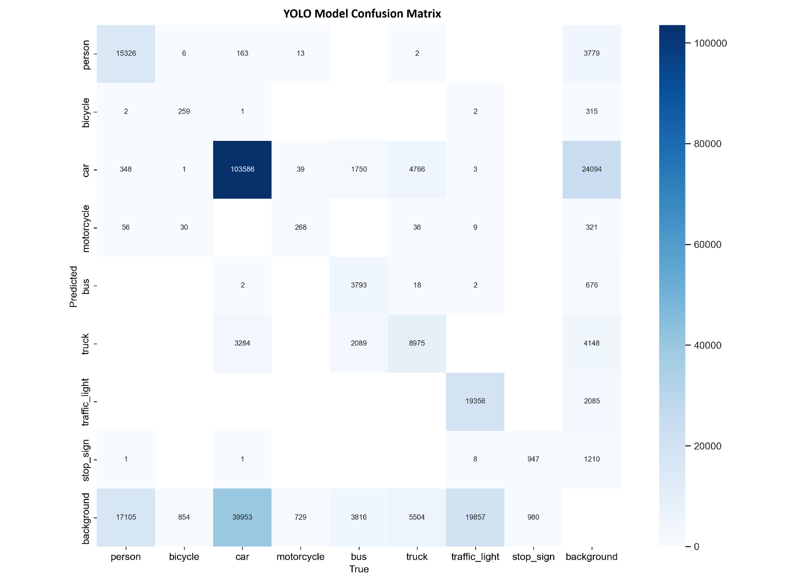
Results – confusion matrix yolo

Slide 15
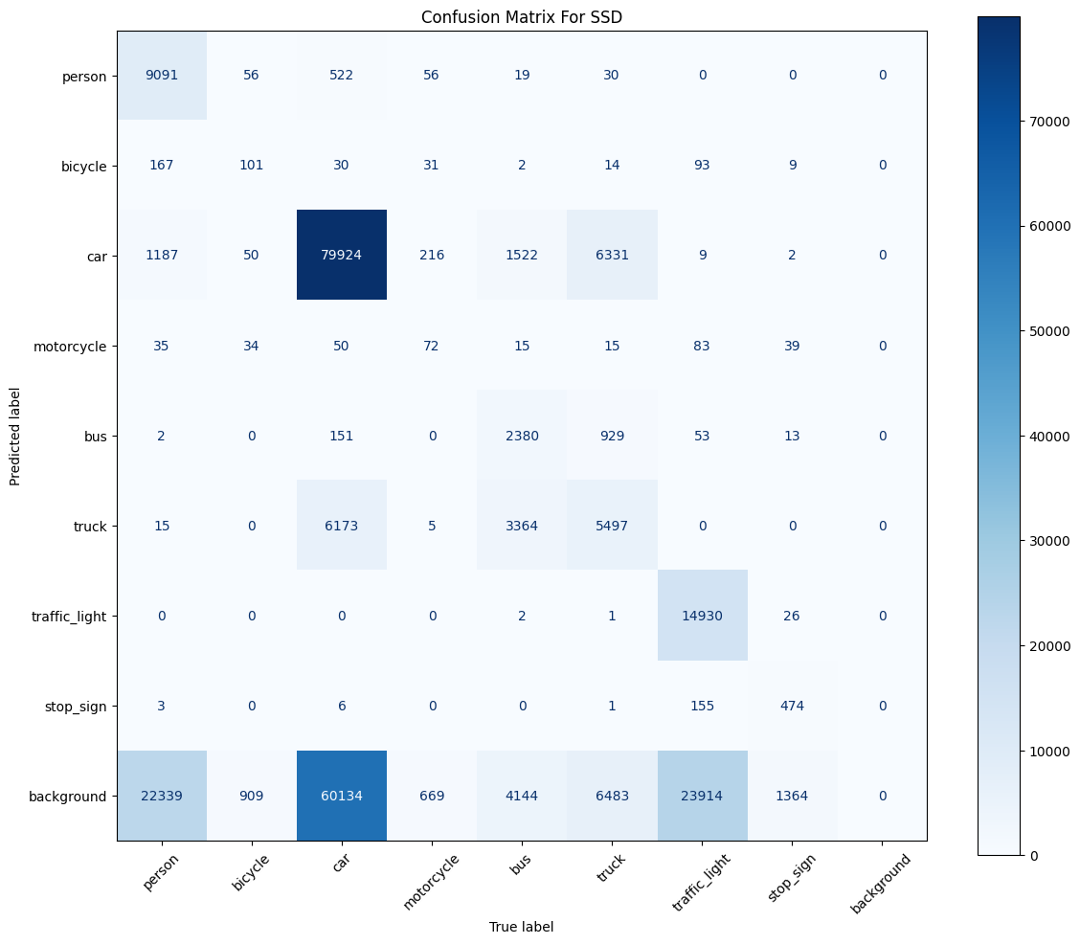
Results – confusion matrix ssd

Slide 16
Results – Inference speed
Target of 16.67ms or less, anything less will work for a 60FPS live feed
YOLO model had an inference speed average of 2.5ms per image
SSD model had an inference speed average of 7.5ms per image

Slide 17
conclusion
YOLO outperformed SSD in the three key metrics: Accuracy, Inference speed and training hardware requirements
Limitations of project: Use of pretrained models, training and evaluation was only conducted on one data source Agroverse-HD

Slide 18
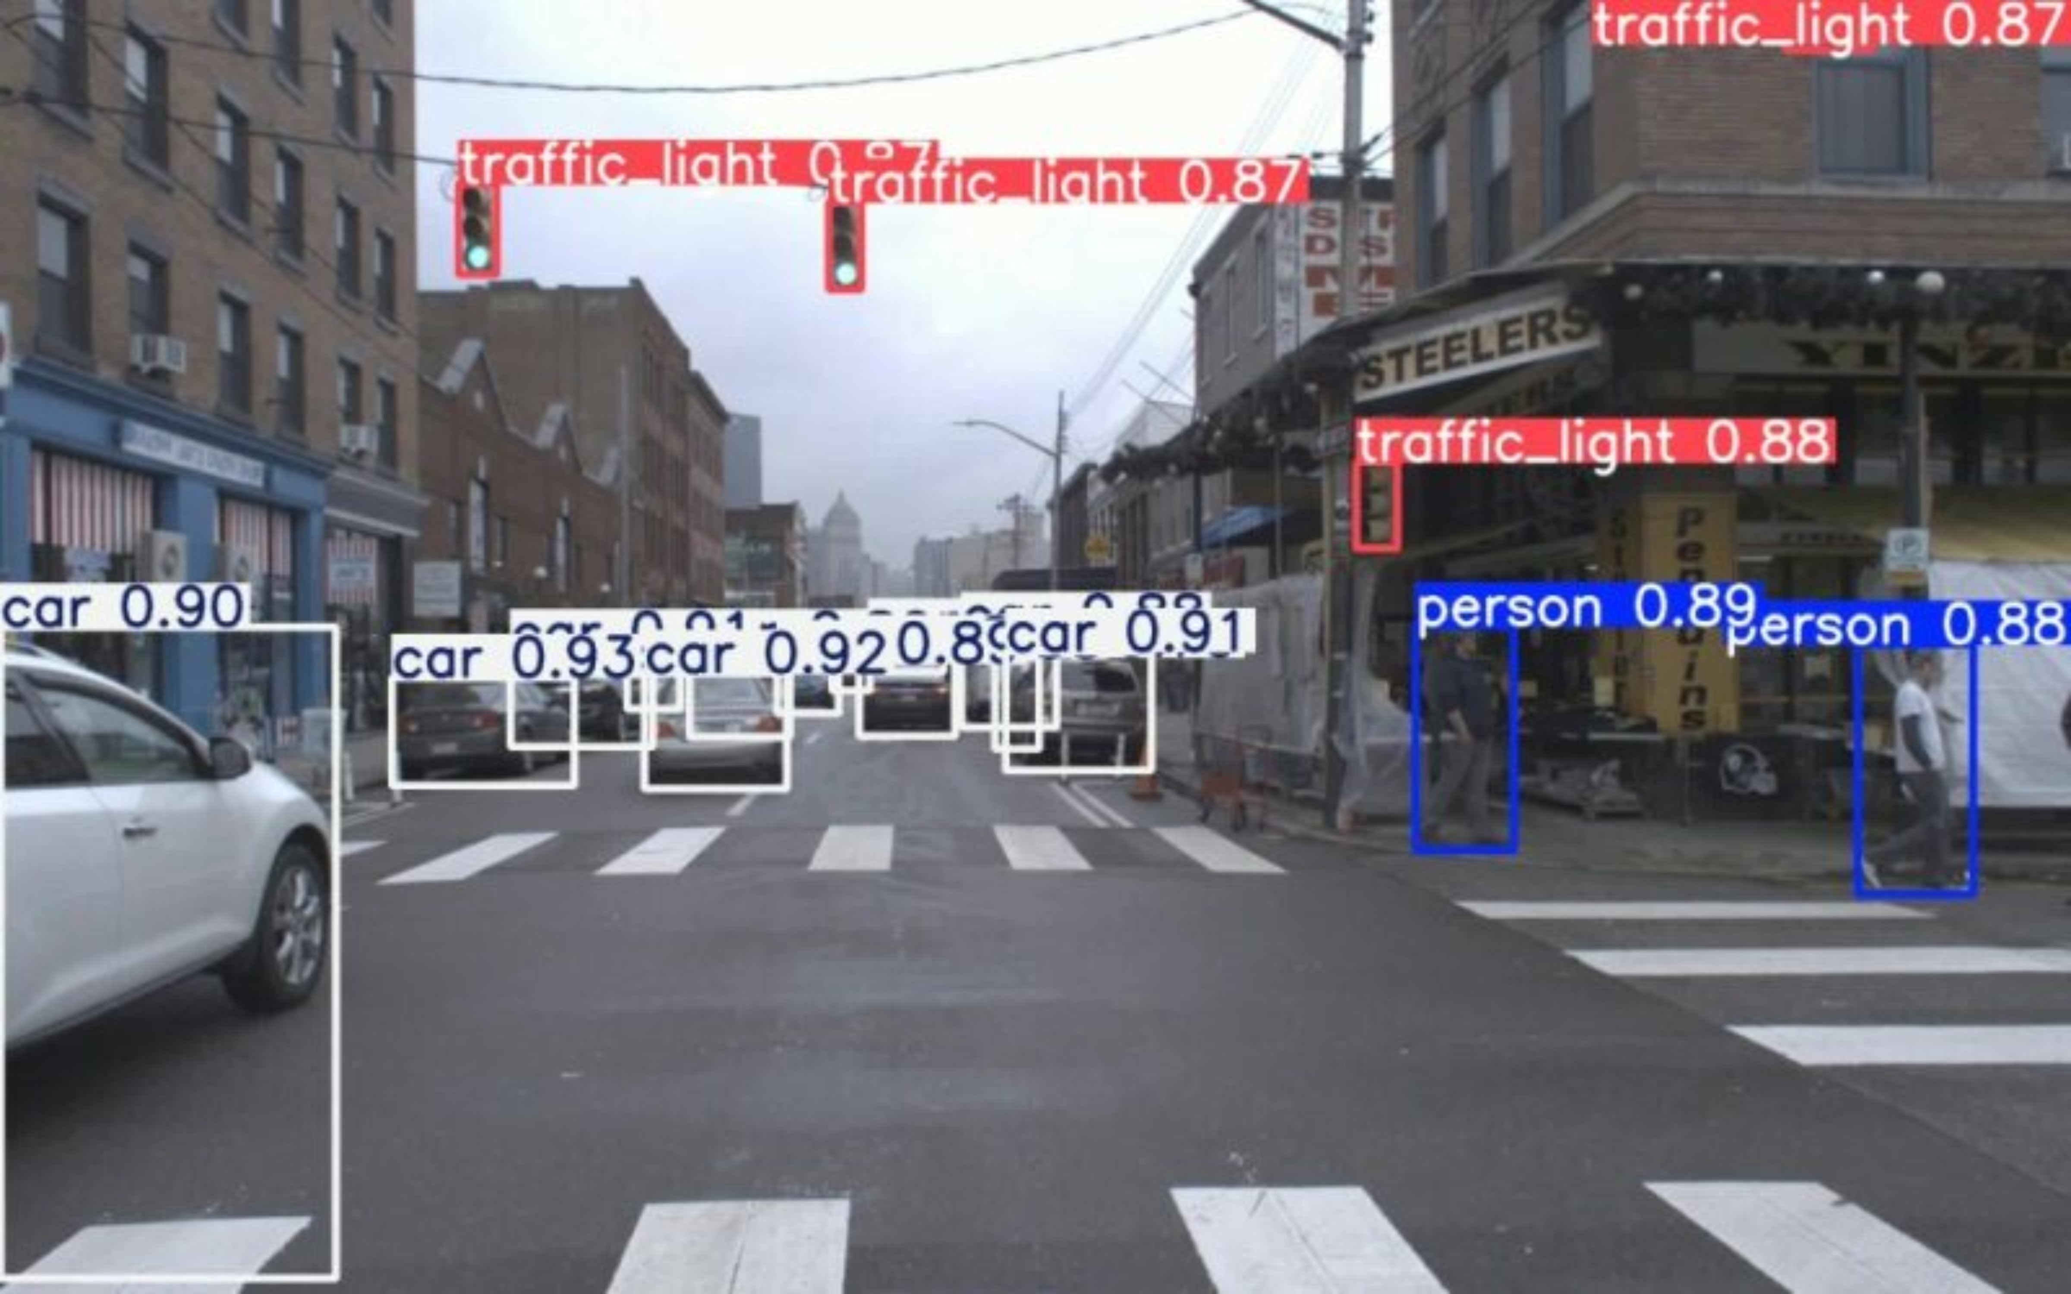
DEMO - yolo

Slide 19
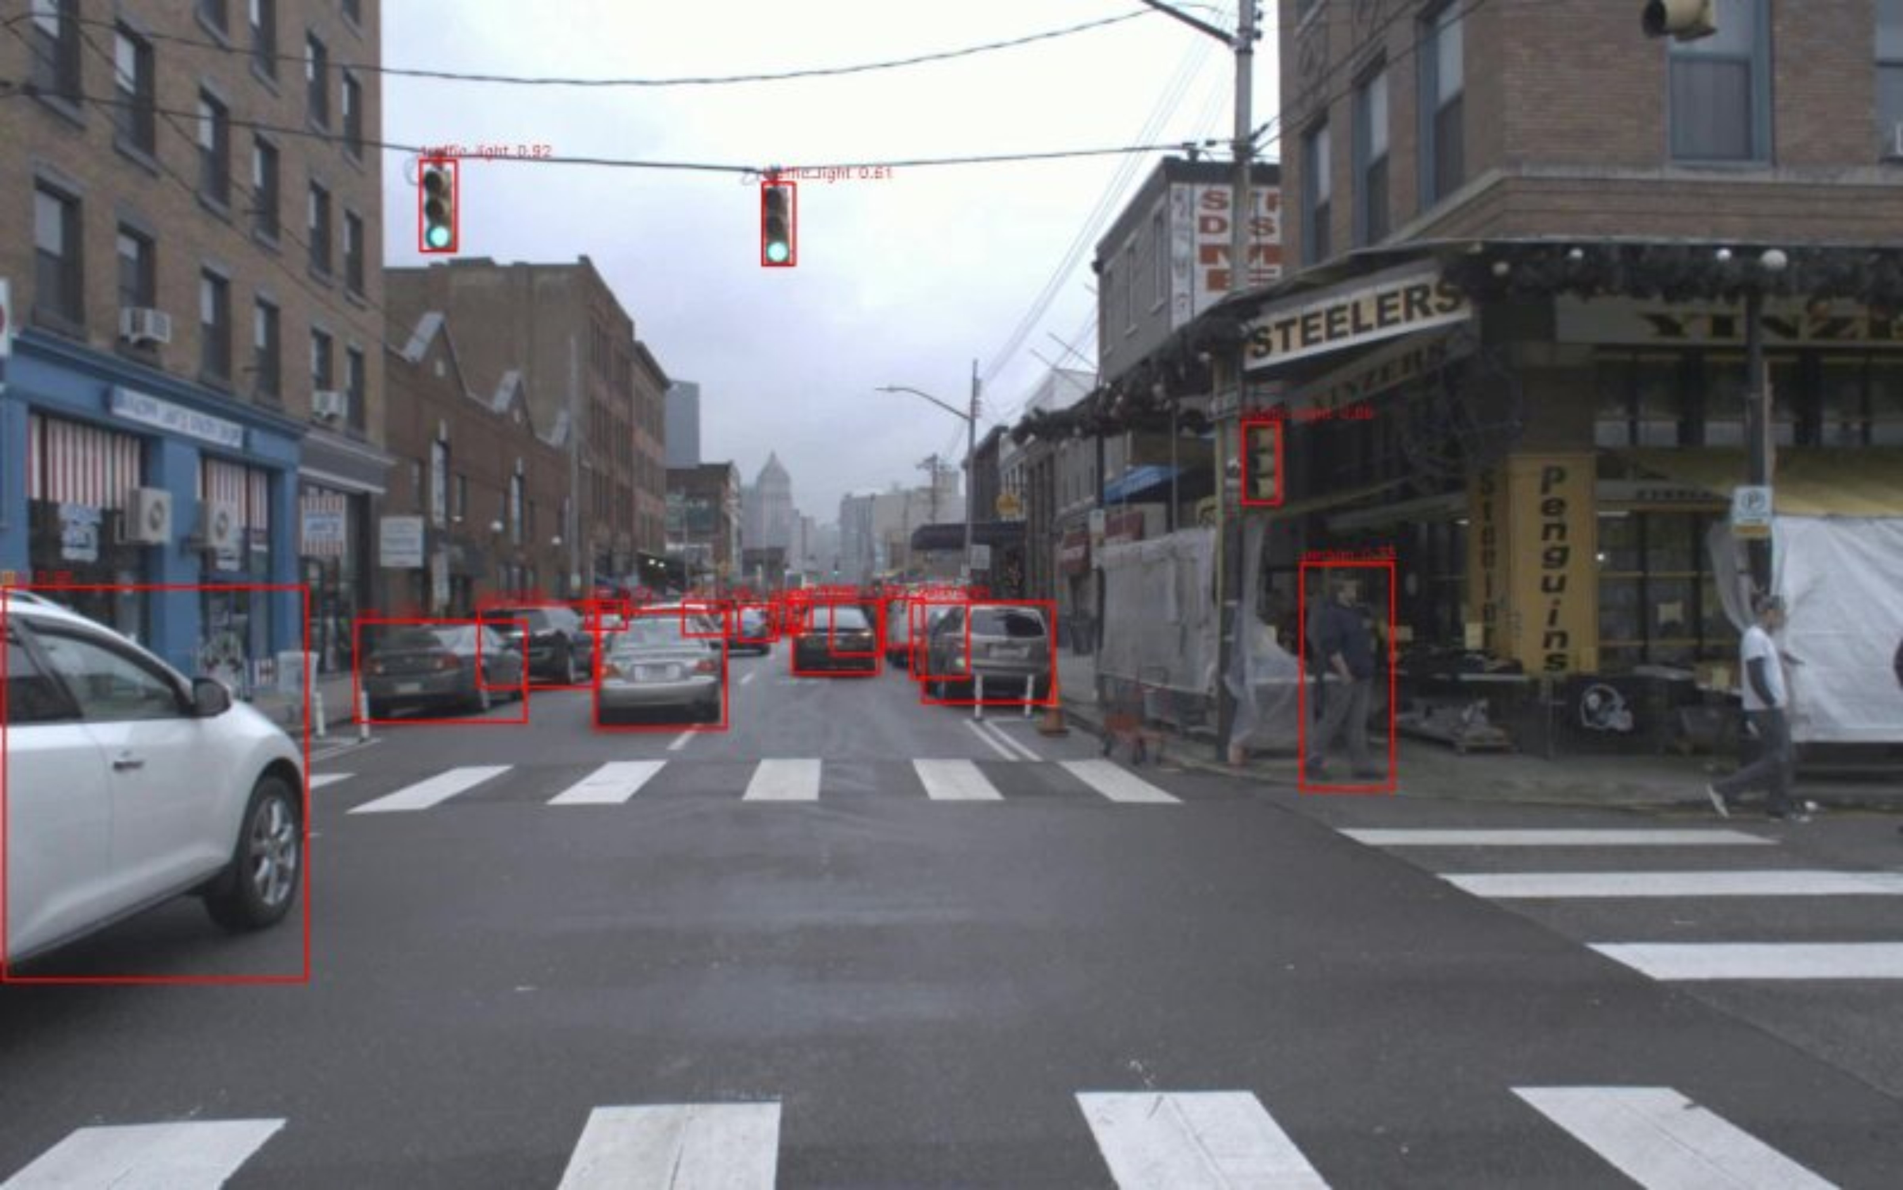
DEMO – ssd

Slide 20
sources
[1] S. Tennekoon, N. Wedasingha, A. Welhenge, N. Abhayasinghe and I. Murray Am, "Advancing Object Detection: A Narrative Review of Evolving Techniques and Their Navigation Applications," in IEEE Access, vol. 13, pp. 50534-50555, 2025
[2] Ren, Shaoqing, et al. “Faster R-CNN: Towards Real-Time Object Detection with Region Proposal Networks.” IEEE Transactions on Pattern Analysis and Machine Intelligence, vol. 39, no. 6, 1 June 2017, pp. 1137–1149, https://doi.org/10.1109/tpami.2016.2577031.
‌[3] Redmon, Joseph, et al. You Only Look Once: Unified, Real-Time Object Detection. 9 May 2016.
[4] Liu, Wei, et al. SSD: Single Shot MultiBox Detector. 29 Dec. 2016.

